Slide 1
SEMESTER ONE
WEEK 11
TOPIC 11
Research Methodology 4
(Semester One 2026)
Selecting a Study Design
(Kumar Chapter 8)
A lecture series
presented by
Dr E. Francke
We will now move from deciding what you want to study to deciding how you will structure the study so that your evidence can answer your research questions.
Research Methodology 4
4 May 2026
Notes:
[Sources] Primary content derived from the uploaded course chapter "Selecting a Study Design (Kumar Chapter 8)" and styled with reference to the uploaded Week 7 and Week 8 presentation examples.

Slide 2
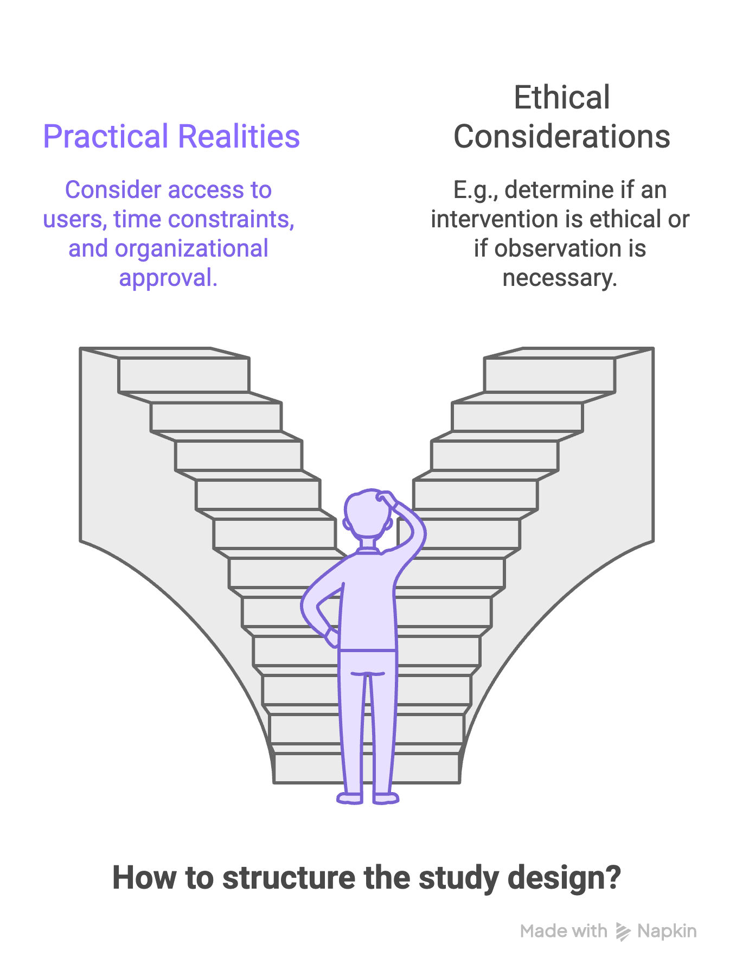
The Study Design
The study design is the blueprint for the study itself and a core decision within your overall research design (Kumar, 2011).
In ICT research, design choices are often shaped by practical realities, such as access to users or systems, time windows, organisational approval, and whether you can ethically introduce an intervention or must only observe what already happens.

Slide 3
By the end of this lecture…
you should be able to:
you should also be able to:
And finally:
Distinguish between Research Design and Study Design.
Define a study design and explain why it matters in research planning.
Differentiate among major quantitative, qualitative, and mixed-methods designs.
Recognise designs based on the number of contacts, the reference period, and the nature of the investigation.
Select a suitable design for an ICT topic and justify the choice.
Compare the strengths and limitations of common designs.
Use a practical decision guide to support your weekly artefact.
We will deal with the entire Research Design process in Semester Two.
Research Methodology 4
2026
Notes:
[Sources] Source: uploaded Week 5 study design chapter.

Slide 4
WHAT IS A RESEARCH DESIGN?
The comprehensive blueprint for the entire research process
Core idea
Why it matters
ICT lens
Kumar defines research design as a procedural plan adopted by the researcher to answer questions validly, objectively, accurately, and economically.
It is a comprehensive blueprint for the entire research process, including the study design, data collection methods, sampling strategy, analytical framework, and time frame.
The research design sets out the specific details of the enquiry, including logistical arrangements, measurement procedures, the sampling strategy, and the analysis plan.
Kumar suggests that you first outline your research design (the overall plan), then specify your study design (the methodological approach), and finally detail the logistical procedures for data collection, sampling, and analysis.
Research Methodology 4
2026
Notes:
[Sources] Source: uploaded Week 5 study design chapter, section A.

Slide 5
WHAT IS A STUDY DESIGN?
The blueprint that structures evidence collection
Core idea
Why it matters
ICT lens
A study design is the logical structure that determines when, from whom, and how you will gather information in order to answer the research questions.
A good design helps you collect information that fits your objectives, make credible arguments, avoid wasted effort, and anticipate limitations early.
In ICT research, design choices are shaped by access to users or systems, time windows, organisational approval, ethics, and whether an intervention can be introduced.
Research Methodology 4
2026
Notes:
[Sources] Source: uploaded Week 5 study design chapter, section A.

Slide 6
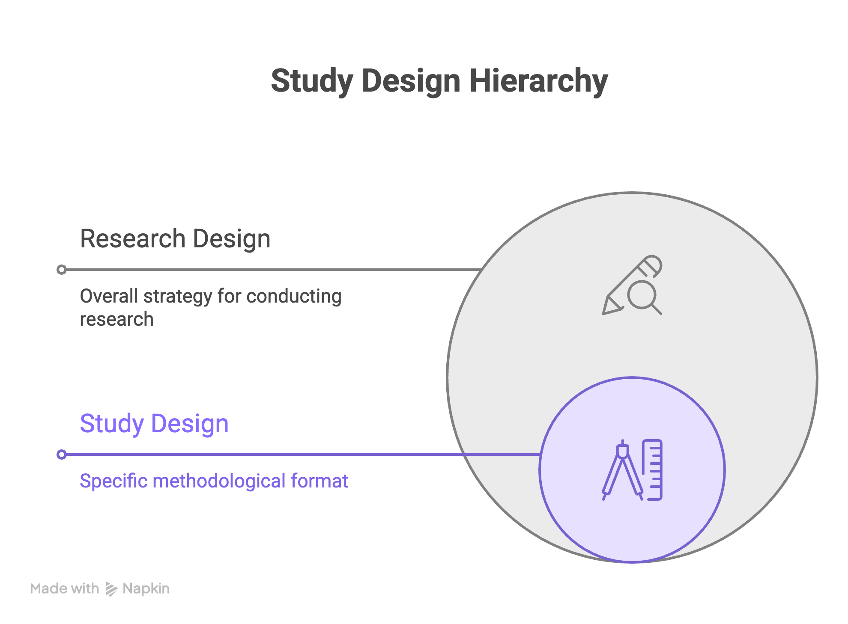
Kumar makes a clear distinction
Study Design is a subset of Research Design.
Research Design is the overall plan, while Study Design is the specific methodological approach within that plan.

Slide 7
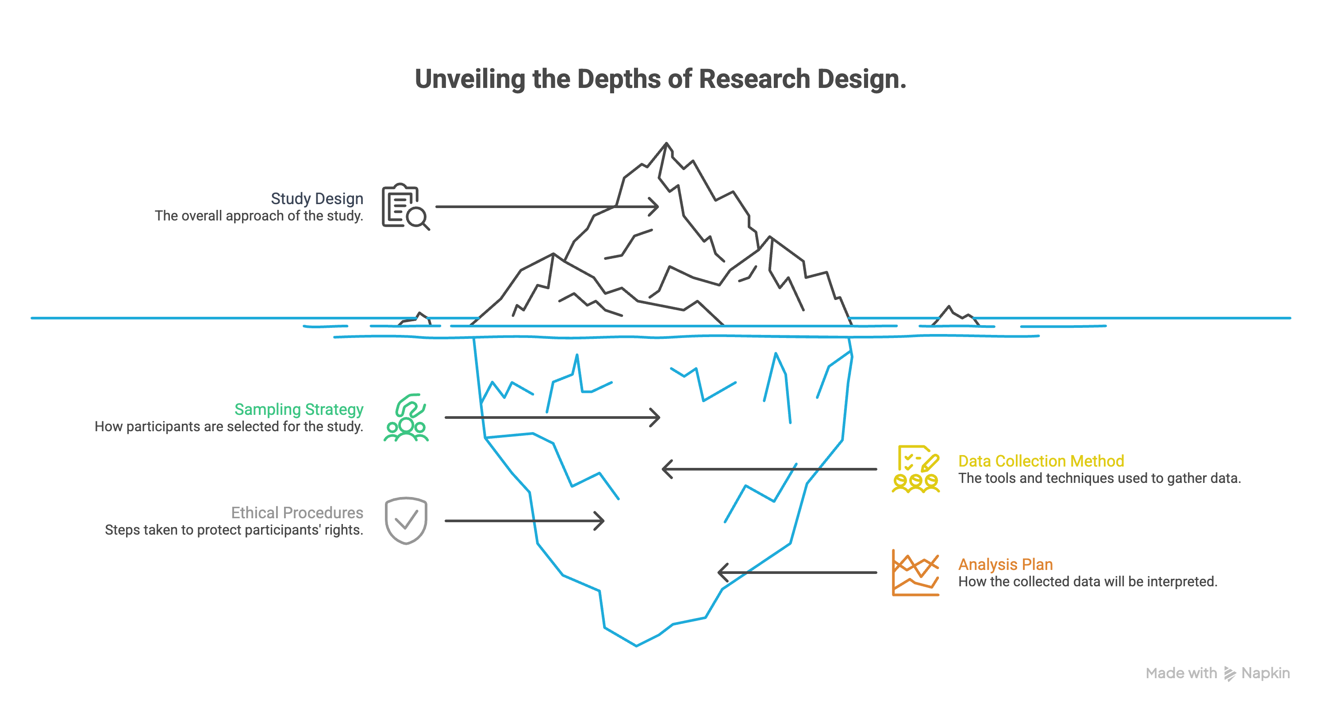
Example: Cross-Sectional Study
Study Design: The study is a cross-sectional survey to assess a population's attitudes towards online gambling.
Research Design: The research design includes:
The cross-sectional study design (one contact with the population).
Sampling strategy (e.g., random sample from the population).
Data collection method (e.g., questionnaire sent to respondents).
Procedures for consent, confidentiality, and response handling.
Analysis plan (e.g., statistical analysis of attitudes).

Slide 8
Key Differences Between Research and Study Design
Research design is the comprehensive, overarching blueprint.
Study design is a specific, narrower component within the research design.
Research Design
Study Design
Overall blueprint, "What/Why"
Highly Broad (Conceptual)
Goals, Methods, Sampling, Data Analysis
To address research questions efficiently
Specific type/layout, "How"
Narrower (Technical)
Case Study, Experimental, Survey
To select the best, valid methodology
Function
Breadth
Contents
Goal
https://guides.lib.vt.edu/researchmethods/design-method
https://pmc.ncbi.nlm.nih.gov/articles/PMC2924977/
2026
Notes:
[Sources] Source: uploaded Week 5 study design chapter, section B.

Slide 9
QUANTITATIVE VS QUALITATIVE STUDY DESIGNS
Two broad traditions with different levels of structure
Quantitative designs
Qualitative designs
Adopts various "study designs" that use objective, numerical data and statistical analysis to test hypotheses or answer questions.
Typically, more structured, fixed, and explicitly defined.
They aim to measure, compare, test, and classify.
Because measurement requires predetermined procedures, the design is usually specified upfront.
Adopts various "study designs" to explore and understand the "how" and "why" of human behaviour, experiences, and social phenomena.
Typically, less rigid, more flexible, and more emergent.
They aim to understand, explain, explore, and clarify feelings, perceptions, attitudes, values, beliefs, and experiences.
The boundary between design and data collection methods is often less sharply defined.
Research Methodology 4
2026
Notes:
[Sources] Source: uploaded Week 5 study design chapter, section B.

Slide 10
QUANTITATIVE DESIGNS
Three ways Kumar groups common quantitative designs
Kumar identifies three perspectives:
number of contacts,
reference period, and
nature of the investigation.
These perspectives help you decide how many times you will contact participants, whether you look backwards or forward in time, and whether you introduce a treatment or only observe
Research Methodology 4
2026
Notes:
[Sources] Source: uploaded Week 5 study design chapter, section C.

Slide 11
DESIGNS BASED ON THE NUMBER OF CONTACTS
How many times you collect information from the study population
Cross-sectional
Before-and-after
Longitudinal
Collect information once, at a single point in time.
Useful for snapshots of current conditions, opinions, behaviours, and associations.
Fast and economical, but weak for showing change or causality.
Collect information at least twice, usually before and after an event or intervention.
Useful for policy changes, system roll-outs, or training interventions.
Measures change directly, but other events may also explain the difference.
Collect information over a longer period to track stability, change, and trajectories.
Useful for adoption over time and long-term effects.
Includes trend, cohort, and panel studies.
Research Methodology 4
2026
Notes:
[Sources] Source: uploaded Week 5 study design chapter, section C.1.

Slide 12
DESIGNS BASED ON THE NUMBER OF CONTACTS
ICT Examples
Cross-sectional
Before-and-after
Longitudinal
A researcher surveys first-year IT students once in April to measure their current use of AI tools, digital literacy, and attitudes toward plagiarism detection.
CPUT measures staff's phishing-awareness scores before cybersecurity training and again 1 month after the training to determine whether the intervention improved recognition of phishing emails.
A researcher tracks the same group of software developers over 12 months to examine how their use of AI coding assistants evolves and whether it affects code quality and review practices.
Research Methodology 4
2026
Notes:
[Sources] Source: uploaded Week 5 study design chapter, section C.1.

Slide 13
DESIGNS BASED ON THE REFERENCE PERIOD
Whether the study looks backward, forward, or both
Retrospective
Prospective
Retrospective–prospective
Begins after the event and looks back for earlier conditions or exposures.
ICT example: reviewing historical incident reports or system logs after a breach.
Efficient when records exist, but limited by data quality and recall bias.
Begins before the outcome occurs and follows cases forward in time.
ICT example: tracking users after a new feature release to observe adoption and satisfaction.
Stronger for sequencing events, but often slower and more resource-intensive.
Combines historical information with forward follow-up.
Useful when some baseline evidence already exists, but more data is still needed to complete the picture.
Research Methodology 4
2026
Notes:
[Sources] Source: uploaded Week 5 study design chapter, section C.2.

Slide 14
DESIGNS BASED ON THE NATURE OF THE INVESTIGATION
Whether you intervene or simply observe
Experimental
Non-experimental
Quasi-experimental
Introduce a treatment or intervention and measure outcomes.
Use controls such as randomisation, matching, and comparison groups.
Best when high control is possible.
Observe variables as they naturally occur without introducing a treatment.
Common in ICT where manipulation is unethical or impractical, such as privacy behaviour or policy effects.
Introduce an intervention, but with limited control over unimportant variables or randomisation.
Often used in real-world organisational settings.
Research Methodology 4
2026
Notes:
[Sources] Source: uploaded Week 5 study design chapter, section C.3.

Slide 15
DESIGNS BASED ON THE NATURE OF THE INVESTIGATION
ICT Examples
Experimental
Non-experimental
Quasi-experimental
A researcher randomly assigns students to two groups: one uses an AI tutoring tool, and the other uses standard online notes, then compares test performance.
A researcher studies how employees naturally use multi-factor authentication in an organisation without changing any settings or introducing any intervention.
A university introduces a new cybersecurity training programme to one department but not another, and the researcher compares phishing-awareness results without random assignment.
Research Methodology 4
2026
Notes:
[Sources] Source: uploaded Week 5 study design chapter, section C.3.

Slide 16
OTHER COMMONLY USED QUANTITATIVE DESIGNS
Useful when you need trends, group tracking, or repeated measures
Replicated cross-
sectional
Trend study
Cohort study
Panel study
Blind and double-blind studies
Follow a group that shares a defining characteristic or experience and examine outcomes over time.
Collect the same information from the same individuals or units over time.
Repeat cross-sectional studies at different points in time, often with different samples from the same population, to detect population-level change.
Collect information from different samples of the same population at several time points to examine shifts in population characteristics.
Used mainly in effectiveness testing to reduce placebo effects and researcher bias.
In blind studies, participants do not know which treatment they receive. In double-blind studies, researchers do not know either.
These designs strengthen evidence about change, stability, and repeated measurement.
Choice depends on feasibility, attrition risk, access to the same individuals, and the level at which change is being studied.
Research Methodology 4
2026
Notes:
[Sources] Source: uploaded Week 5 study design chapter, section D.

Slide 17
Kumar notes that qualitative designs are less precisely defined than quantitative designs, and there can be overlap between design and data collection methods.
QUALITATIVE DESIGNS
Flexible designs for rich, in-depth understanding
Research Methodology 4
2026
Notes:
[Sources] Source: uploaded Week 5 study design chapter, section E.

Slide 18
STUDY DESIGNS IN QUALITATIVE RESEARCH
Seven common designs and associated strengths
Case study
Treats one bounded case as the basis for holistic, in-depth exploration.
Oral history
Uses personal accounts to reconstruct events, experiences, or social processes.
Focus groups and group interviews
Use guided discussion to generate detailed views from participants.
Participant observation
Builds rich understanding through close interaction and detailed notes.
Holistic research
Understanding a phenomenon in its totality and from multiple perspectives.
Community discussion forums
Gather views on community issues through large-scale open discussion.
Reflective journal log
Uses structured reflective notes as a basis for analysis and conclusions.
Research Methodology 4
2026
Notes:
[Sources] Source: uploaded Week 5 study design chapter, section E.

Slide 19
STUDY DESIGNS IN QUALITATIVE RESEARCH
Examples of seven common designs
Case study
A researcher investigates how one university IT department introduced AI chatbots for student support and explores the rollout process, staff experiences, and student responses in depth.
Oral history
A researcher interviews retired ICT professionals to document how banking systems changed from paper-based processes to digital platforms over time.
Focus groups and group interviews
A researcher holds focus groups with computer science students to discuss their experiences of using AI coding tools for assignments.
Participant observation
A researcher spends time with a software development team, observing daily stand-ups, coding practices, and code reviews to understand how collaboration happens in practice.
Holistic research
A researcher studies the implementation of an e-learning platform by looking at the technology, student experiences, lecturer practices, support systems, and institutional policies together.
Community discussion forums
A municipality hosts an open community forum where residents discuss challenges with access to online government services, digital literacy, and connectivity.
Reflective journal log
An intern working in a cybersecurity unit keeps a structured journal of incidents, responses, team discussions, and personal reflections to analyse patterns in security practice.
Research Methodology 4
2026
Notes:
[Sources] Source: uploaded Week 5 study design chapter, section E.

Slide 20
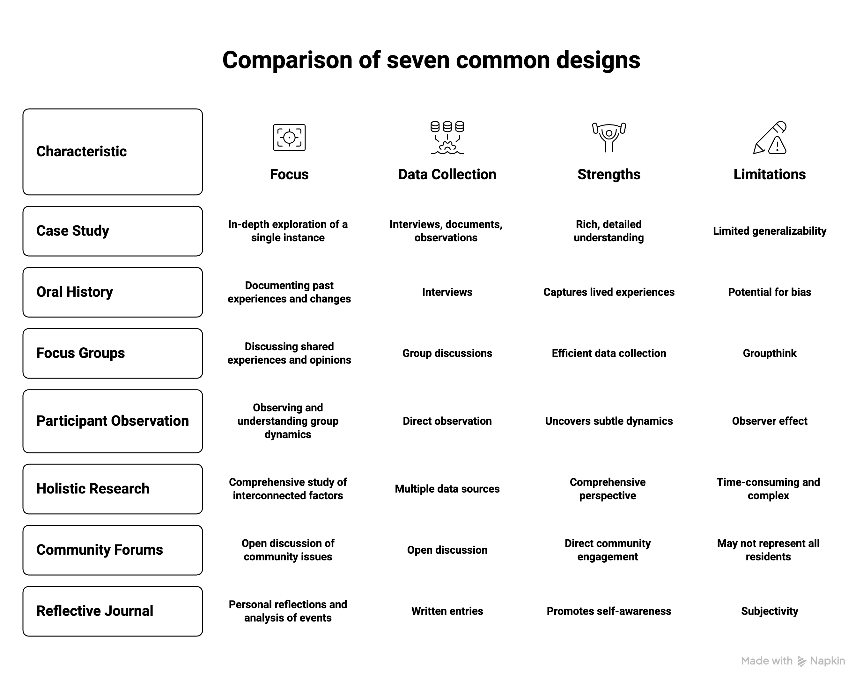

Slide 27
Systematic Literature Review
A systematic literature review can be qualitative, quantitative, or a combination.
Your Study Design (RME 4 students)
We have so far looked at different study designs that aim to answer a specific question.
A systematic literature review is a study design used to summarise the results of several primary research studies.
An SLR can be qualitative, quantitative, or a mixture of both, depending on the research question and the evidence gathered.
It is defined by its rigorous, pre-planned methodology (e.g., PRISMA guidelines) rather than the data type, aiming to minimise bias when answering a specific question.
The process is transparent, allowing other researchers to replicate the review.
Differences in study designs, populations, or interventions can make SLRs difficult to compare or combine findings.
Research Methodology 4
2026
Notes:
[Sources] Source: uploaded Week 5 study design chapter, section E.

Slide 28
STRENGTHS AND CAUTIONS IN QUALITATIVE DESIGNS
What qualitative designs do especially well
Strengths
Common cautions
Rich, contextual understanding
Depth rather than breadth
Useful when little is known
Good for process, meaning, experience, and interaction
Supports multiple methods in combination
Limited broad generalisation
Dominant voices can affect group discussions
Researcher bias must be managed carefully
Close involvement takes time and reflexive discipline
Research Methodology 4
2026
Notes:
[Sources] Source: uploaded Week 5 study design chapter, section E.

Slide 29
PHILOSOPHY-GUIDED APPROACHES
Approaches that shape the role of participants and the purpose of inquiry
Action research
Feminist research
Participatory enquiry
Collaborative enquiry
Combines research and action to improve practice or support change. Often linked to community development and participation from problem identification to implementation.
Guided by feminist concerns and women’s lived experiences. Seeks to reduce power imbalances and address social inequality.
Actively involves participants or communities in the research process to minimise the gap between researcher and researched.
Emphasises engagement, co-creation, and the dual role of researcher and organiser.
Research Methodology 4
2026
Notes:
[Sources] Source: uploaded Week 5 study design chapter, section F.

Slide 30
MIXED METHODS
Creswell’s core designs for integrating qualitative and quantitative data
Selecting a Study Design
Mixed methods intentionally combines data types so that the strengths of one strand help compensate for the limits of the other.
Research Methodology 4
2026
Notes:
[Sources] Source: uploaded Week 5 study design chapter, section G.

Slide 31
CORE MIXED METHODS DESIGNS
Three primary structures used in most mixed methods studies
Convergent parallel
(QUAN + QUAL)
Explanatory sequential
(QUAN → qual)
Exploratory sequential
(QUAL → quan)
Collect quantitative and qualitative data at roughly the same time.
Analyse them separately.
Merge the results to compare whether they confirm, expand, or challenge each other.
Start with a quantitative phase to identify patterns or trends.
Follow with qualitative data to explain the quantitative results in more depth.
Start with qualitative exploration.
Use the findings to build a quantitative tool, scale, or instrument that can be tested with a larger population.
Research Methodology 4
2026
Notes:
[Sources] Source: uploaded Week 5 study design chapter, section G.1.

Slide 32
CORE MIXED METHODS DESIGNS
IT examples for each design
Convergent parallel
(QUAN + QUAL)
Explanatory sequential
(QUAN → qual)
Exploratory sequential
(QUAL → quan)
A researcher studies student satisfaction with a university's learning management system. At the same time, they collect survey data on usability scores and interview data on student experiences. The two sets are analysed separately and then merged to see whether the interview themes support or challenge the survey results.
A researcher first distributes a survey to IT staff to measure the adoption of multi-factor authentication across departments. The results show that one department has unusually low adoption. The researcher then conducts follow-up interviews with staff in that department to explain why adoption is low.
A researcher begins by conducting focus groups with software developers to explore the challenges they face when using AI code assistants. The themes from these discussions are then used to design a questionnaire distributed to a larger group of developers to gauge how common those challenges are.
Research Methodology 4
2026
Notes:
[Sources] Source: uploaded Week 5 study design chapter, section G.1.

Slide 33
MIXED METHODS IN ICT RESEARCH
How the three core designs are applied in practice
Explanatory sequential
Exploratory sequential
Convergent parallel
Common when survey or platform data reveals an unexpected pattern.
ICT example: large-scale data shows low e-government adoption; interviews with managers and users explain why.
Useful when developing new ICT tools, scales, or requirements.
ICT example: interviews reveal student pain points in online learning, then those themes become survey items or feature requirements.
Useful when technical performance and human experience need to be viewed together.
ICT example: compare server performance metrics with user diaries or satisfaction data in a joint display.
Research Methodology 4
2026
Notes:
[Sources] Source: uploaded Week 5 study design chapter, section G.3.

Slide 34
PRACTICAL DECISION GUIDE FOR ICT STUDIES
Five questions that help you choose the right design
1
Do I need a snapshot, or evidence of change over time?
2
Am I looking backward using existing records, or forward as outcomes unfold?
3
Can I ethically and practically introduce an intervention, or must I observe natural behaviour?
4
Do I need in-depth understanding of one bounded case, or measurable patterns across a population?
5
What constraints shape my access, timeframe, and ability to repeat measurements?
Research Methodology 4
2026
Notes:
[Sources] Source: uploaded Week 5 study design chapter, section H.

Slide 35
MATCHING DESIGN TO QUESTION TYPE
Some ICT situations…
Use cross-sectional or trend designs when…
Use case study or participant observation when…
Use before-and-after, longitudinal, or quasi-experimental designs when…
you need prevalence, patterns, or a broad picture of current conditions, such as current opinions about a platform or current levels of digital readiness.
you need a bounded, in-depth understanding of process, context, or meaning, such as how one software team uses AI assistants in practice.
you want to study change after a roll-out, intervention, or policy shift, but real-world constraints limit full experimental control.
Research Methodology 4
2026
Notes:
[Sources] Interpretive summary based on uploaded Week 5 chapter themes.

Slide 36
STRENGTHS AND LIMITATIONS SUMMARY
No design is perfect, only more or less suitable
What strong design choice looks like
Typical trade-offs
The design fits the objectives.
The design is feasible within time, access, ethics, and resources.
The design produces evidence that can answer the question credibly.
The limitations are known and mitigation strategies are planned.
Breadth vs depth
Speed vs follow-up over time
Ease of access vs quality of evidence
Research Methodology 4
2026
Notes:
[Sources] Interpretive summary based on uploaded Week 5 chapter.

Slide 37
TUTORIAL SCENARIO
Choose the most suitable design for an ICT topic
Scenario
Possible answer path
An institution introduces a new learning management system feature and wants to know whether student usage improves and how students experience the change over the next semester.
Quantitative angle: before-and-after or longitudinal tracking of usage data.
Qualitative angle: focus groups or interviews to understand student experience.
Mixed methods angle: explanatory sequential if the usage data comes first, and interviews are used to explain the pattern.
Research Methodology 4
2026
Notes:
[Sources] Scenario constructed from the logic of the uploaded Week 5 chapter for tutorial application.

Slide 38
SUMMARY
Key takeaways to remember
Study Design is a subset of Research Design.
Research Design is the overall plan, while Study Design is the specific methodological approach within that plan.
A study design is the blueprint that determines when, from whom, and how information will be collected.
Quantitative designs are usually more structured; qualitative designs are usually more flexible and emergent.
Kumar groups quantitative designs by number of contacts, reference period, and the nature of the investigation.
Qualitative and philosophy-guided approaches are useful when depth, context, participation, and lived experience matter.
The best design is the one that fits the question, the context, and the study's practical constraints.
Research Methodology 4
2026
Notes:
[Sources] Summary based on uploaded Week 5 chapter.

Slide 39
Thank you
Questions and discussion
Research Methodology 4
2026
Notes:
[Sources] Closing slide.

